Slide 1

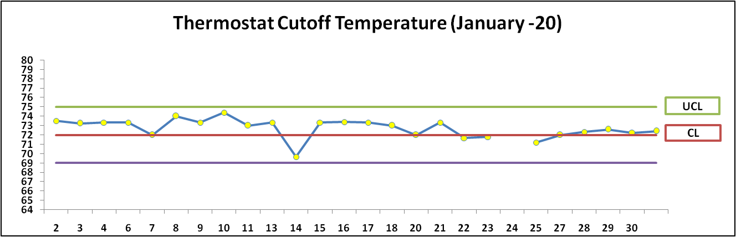
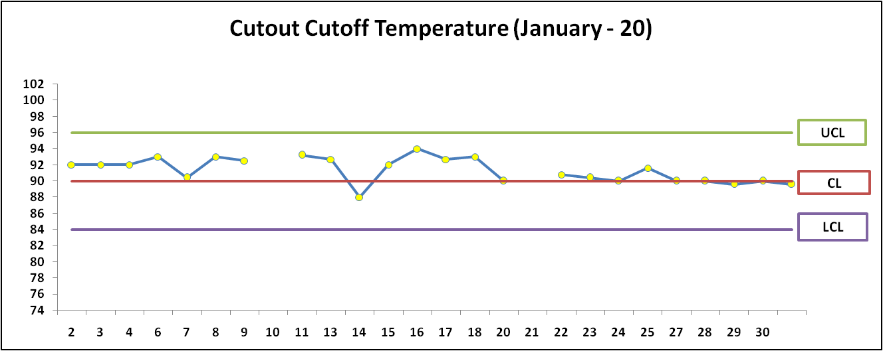
Daily Run chart Monitoring
LCL
Prepared By:-
Reviewed By:-
Approved By:-

Slide 2
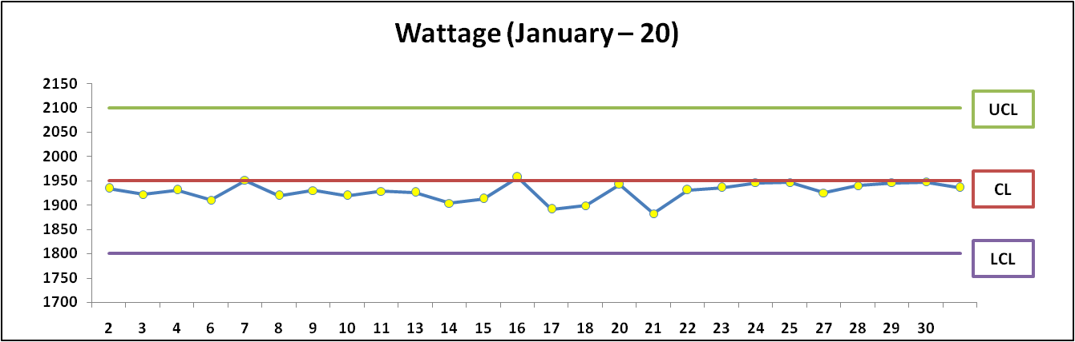
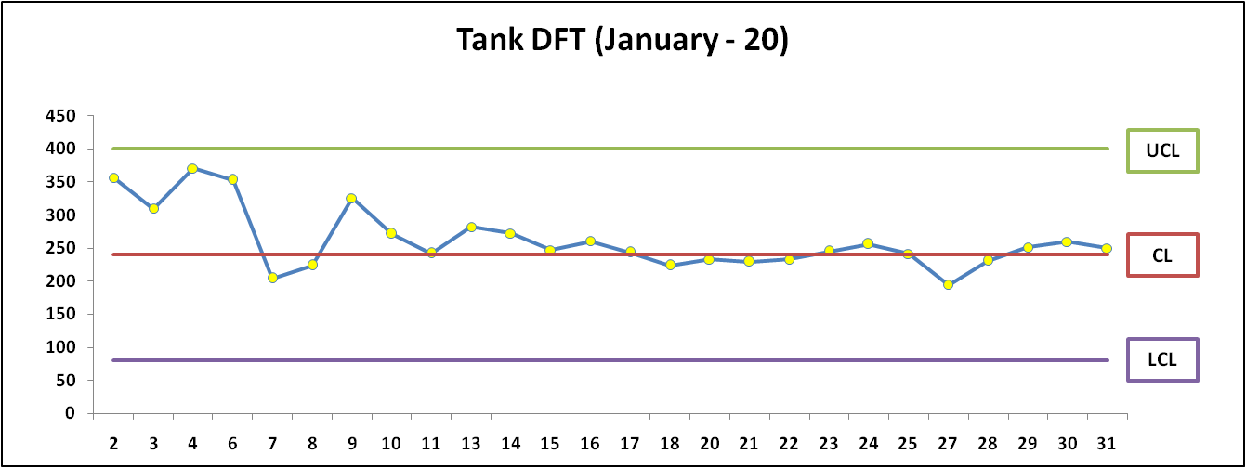
Daily Run chart Monitoring
Prepared By:-
Reviewed By:-
Approved By:-

Slide 3
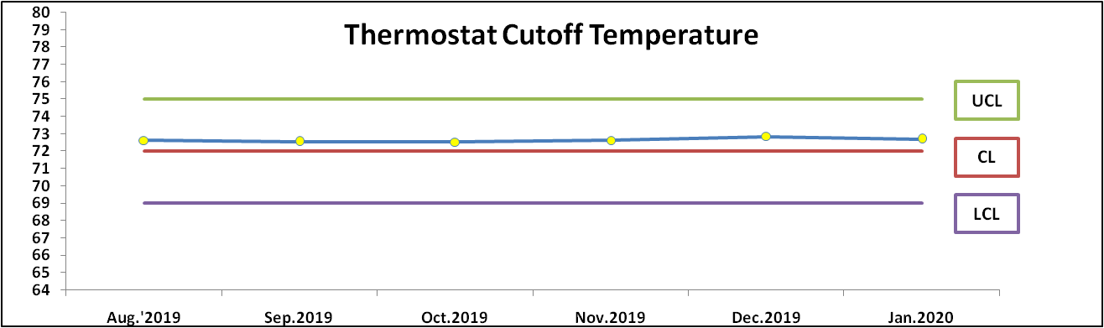
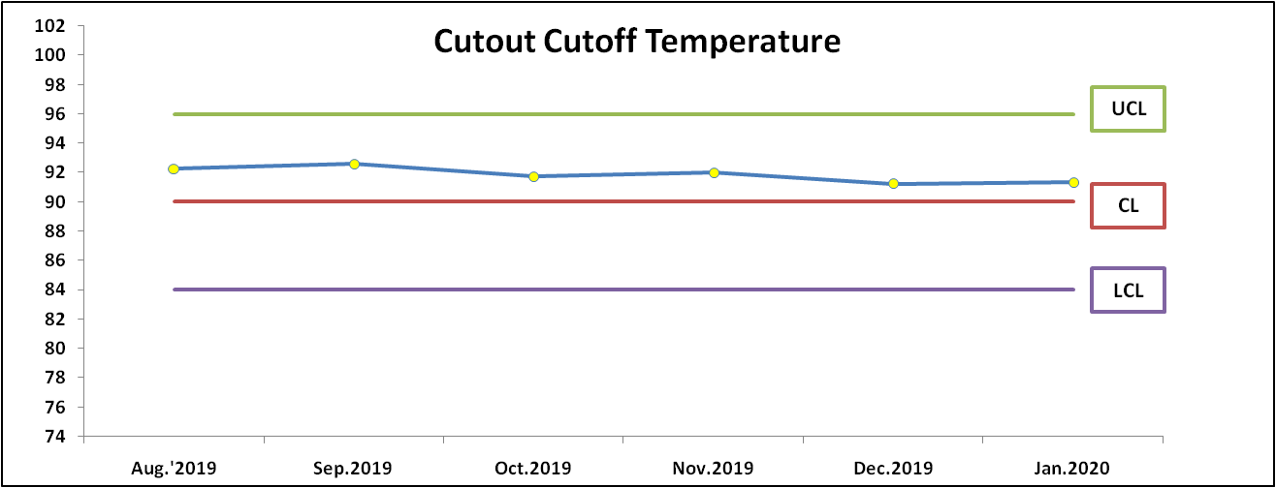
Month wise Run chart Monitoring
Prepared By:-
Reviewed By:-
Approved By:-

Slide 4
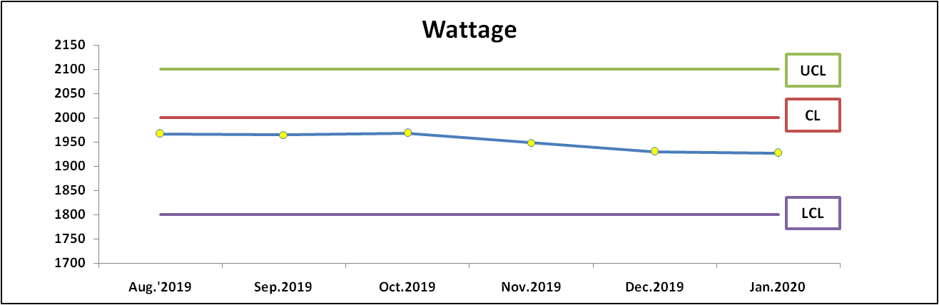
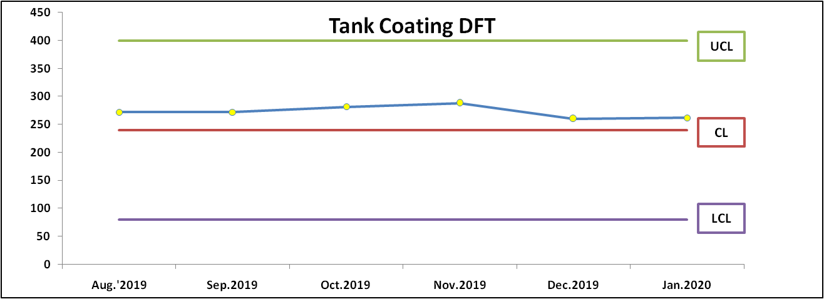
Month wise Run chart Monitoring
Prepared By:-
Reviewed By:-
Approved By:-

Slide 5
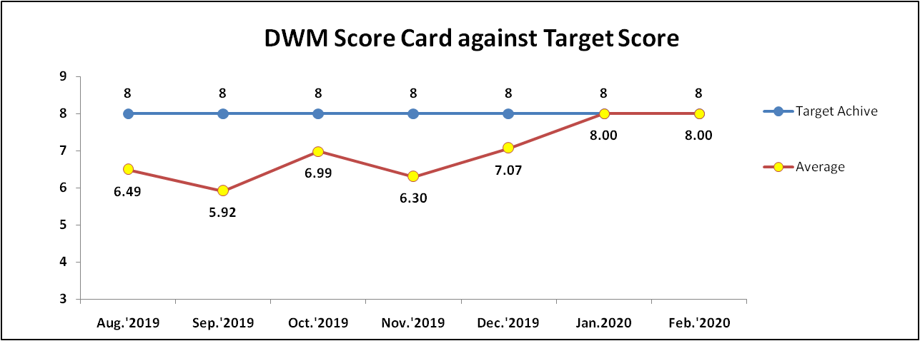
DWM Month wise Score Card
Month | Causes | Action
Aug.'2019 | New Project Lack of awareness/Training | Training Imparted & Improvement seen
Sep.'2019 | Trained People Left to the Company | New joining Imparted training
Oct.'2019 | 1-Lab SOP 2-Visual Detection Sample | 1-LAB SOP in English 2-Visual Detection Sample alies at Assembly
Nov.'2019 | 1-Lack of Defect & Detection Analysis 2-Awarness about CAPA | 1-Training Imparted for Defect & Detection Analysis 2-Training Imparted for Awareness about CAPA
Dec.2019 | Separate Session for RCA Concept | weekly meeting scheduled on behalf of NC Observe in Process.
Prepared By:-
Reviewed By:-
Approved By:-

